Slide 1
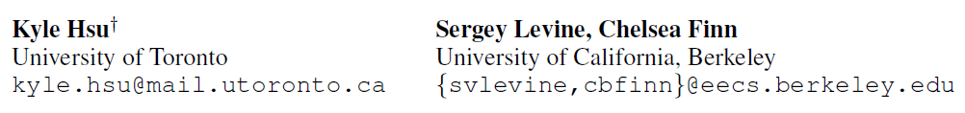
[ICLR19] Unsupervised Learning via Meta-Learning
1
Notes:
无监督+元学习，无监督的目标就是学到一个比较好的表示可以在下游任务上表现出色

Slide 2
Motivation
Meta-learning currently relies on large labeled datasets
State-of-the-art unsupervised learning methods often neglect downstream use-cases
2
Notes:
介绍data to text任务

Slide 3
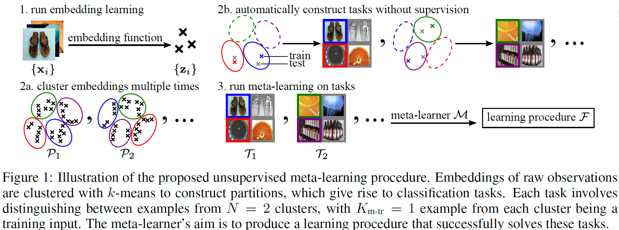
Approach
3

Slide 4
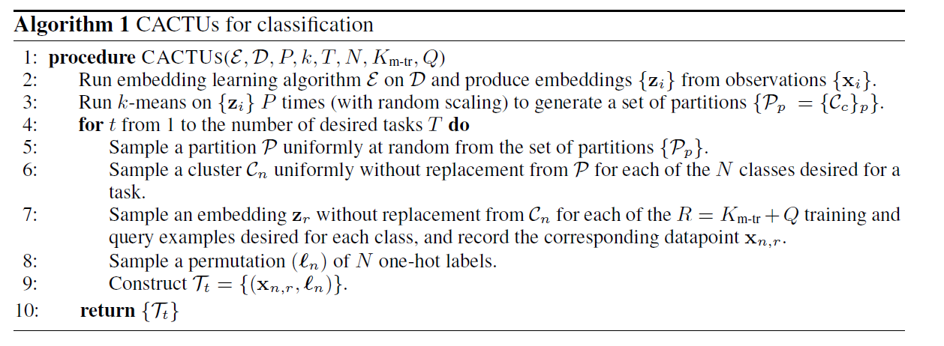
Approach
4

Slide 5
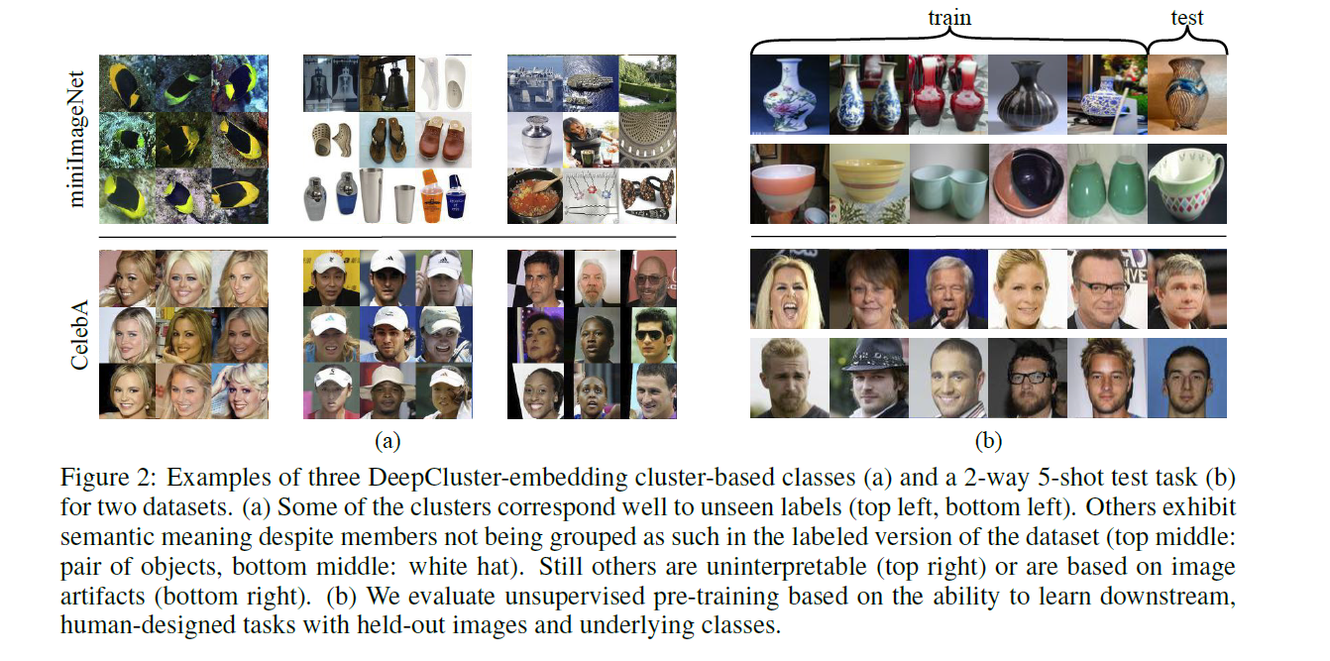
Approach
5
Notes:
模型架构由四部分组成
SE：用来计算K对T中每个单词的支持度。
S2SG是一个transformer架构用来生成本文。
SA用来调节对单词的支持度，主要是为了减少过拟合设计的。
RBS用来平衡，以防生成的句子中单词不平衡。

Slide 6
Benefit of meta-learning
Embedding knn-nearest neighbors
Embedding linear classifier
Embedding multilayer perceptron and tuned dropout
Embedding cluster matching
Forgo unsupervised pre-training and train MAML from standard random network initialization
6

Slide 7
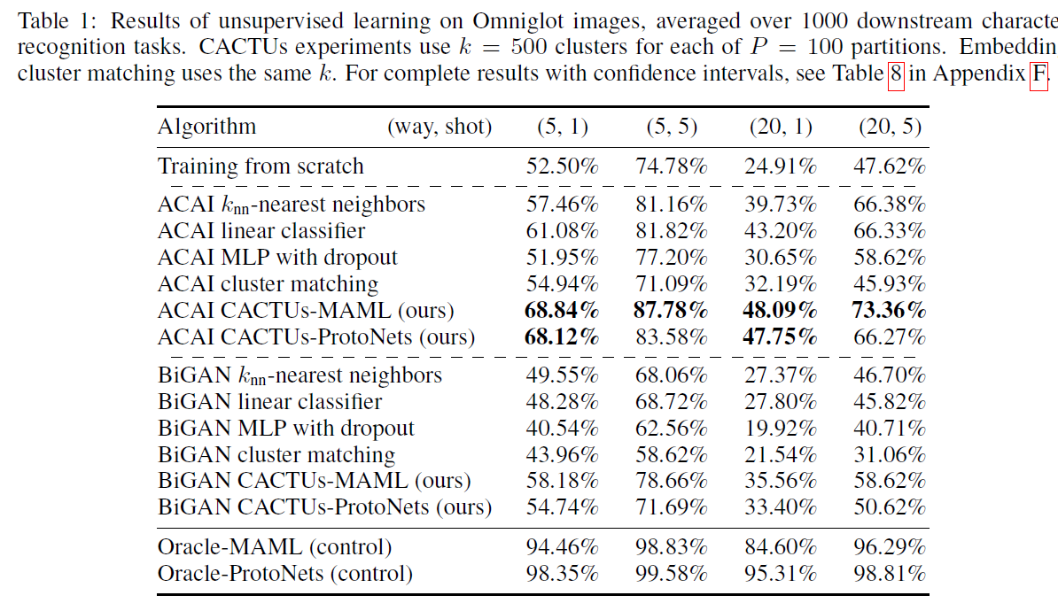
Benefit of meta-learning
7
Notes:
对比不同meta learning的方法
这个数据集上ACAI embedding的方法不错

Slide 8
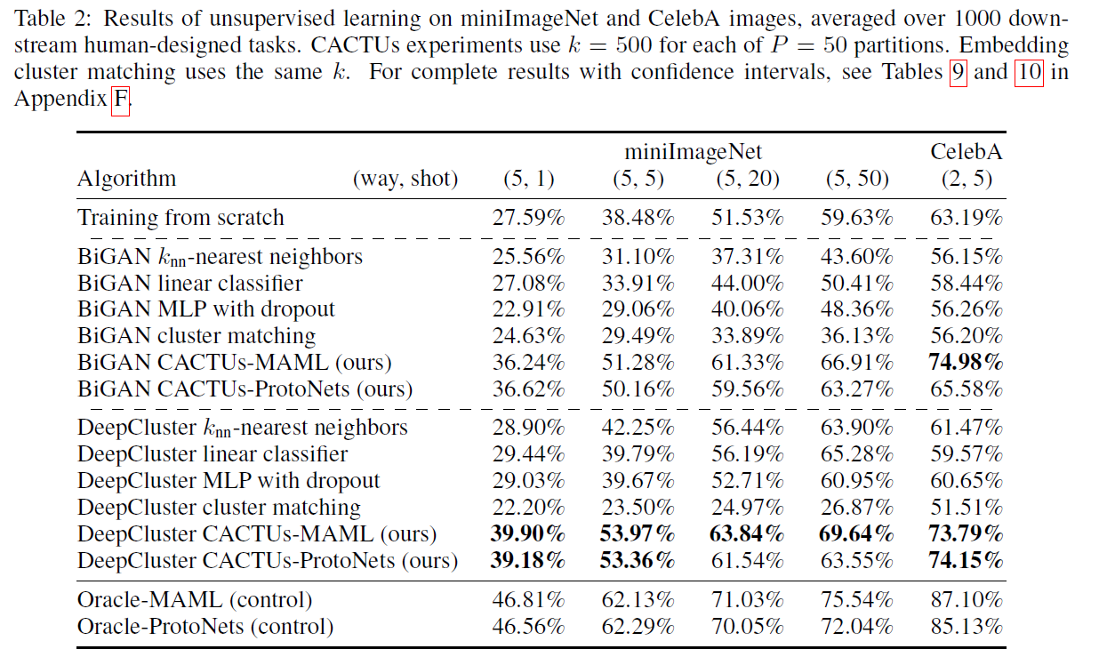
Embedding
8
Notes:
这个数据集上DeepCluster的表现不错

Slide 9
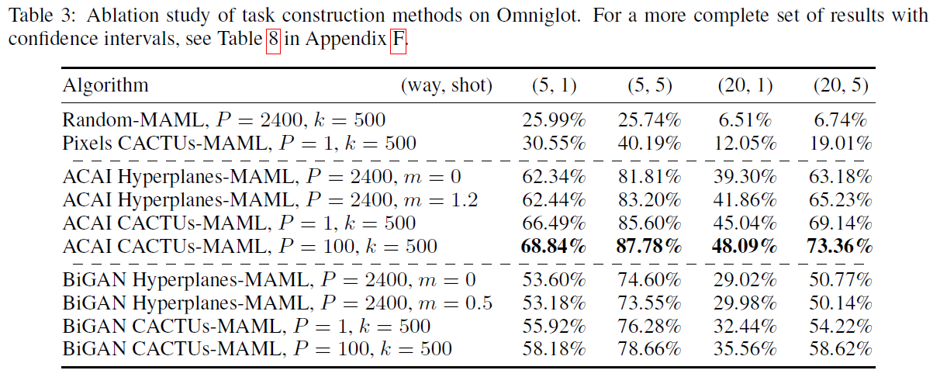
Task construction ablation
9
Notes:
P次K个簇
Random-MAML，随机构建任务
tasks based on pixel-space clusters (Pixels CACTUs-MAML)
基于随机变边界嵌入空间的超平面切片构造任务的MAML(Hyperplanes-MAML).

Slide 10
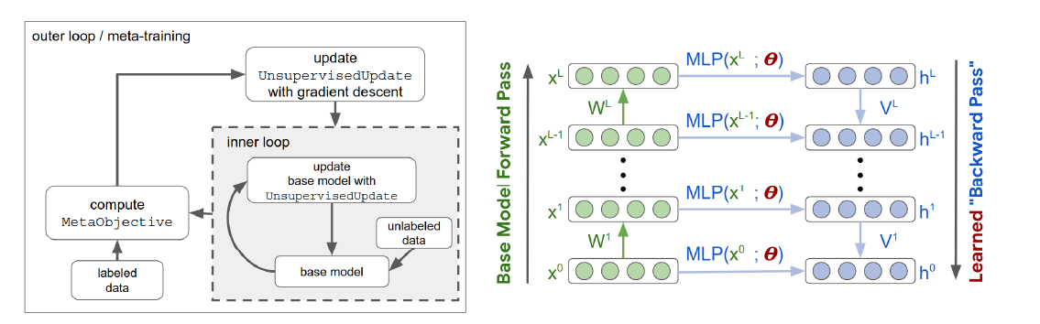
Similar work
[ICLR19]Unsupervised Learning via Meta-Learning
10

Slide 11
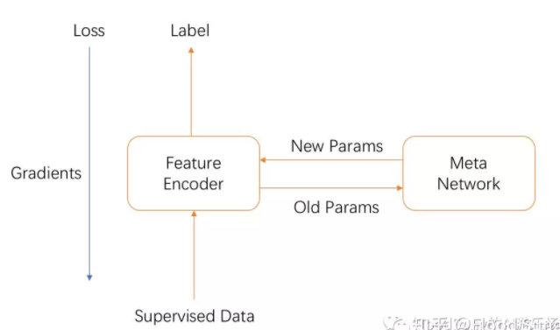
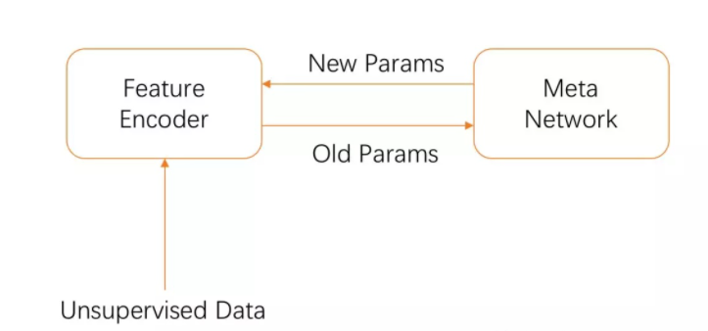
Similar work
11

Slide 12
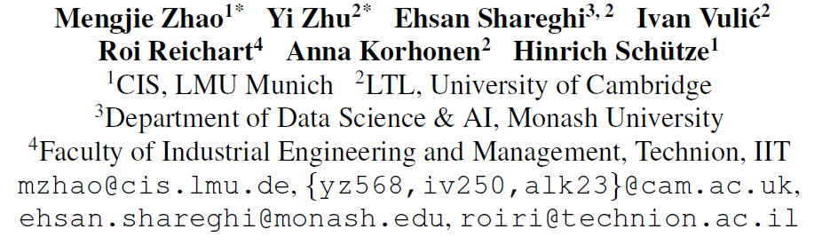
[ACL21] A Closer Look at Few-Shot Crosslingual Transfer: The Choice of Shots Matters
12
Notes:
无监督+元学习，无监督的目标就是学到一个比较好的表示可以在下游任务上表现出色

Slide 13
Motivation
Analyze the design of few-shot experiments
The selection of few shots
Type of downstream task.
Different Numbers of Shots
13
Notes:
介绍data to text任务

Slide 14
Experiment
FS-XLT
Source-training：mBERT +source language(En)
Target-adapting：few shot + target language
Types of tasks
Sequence classification (CLS),
Named entity recognition (NER)
part-of-speech tagging (POS)
14
Notes:
介绍data to text任务

Slide 15
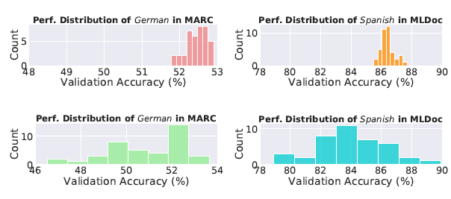
Variance of Few-Shot Transfer
large model complexity & small amount of data
much larger variance in different task
fixed set of few shots
Random seed
Different task*
15
Notes:
介绍data to text任务

Slide 16
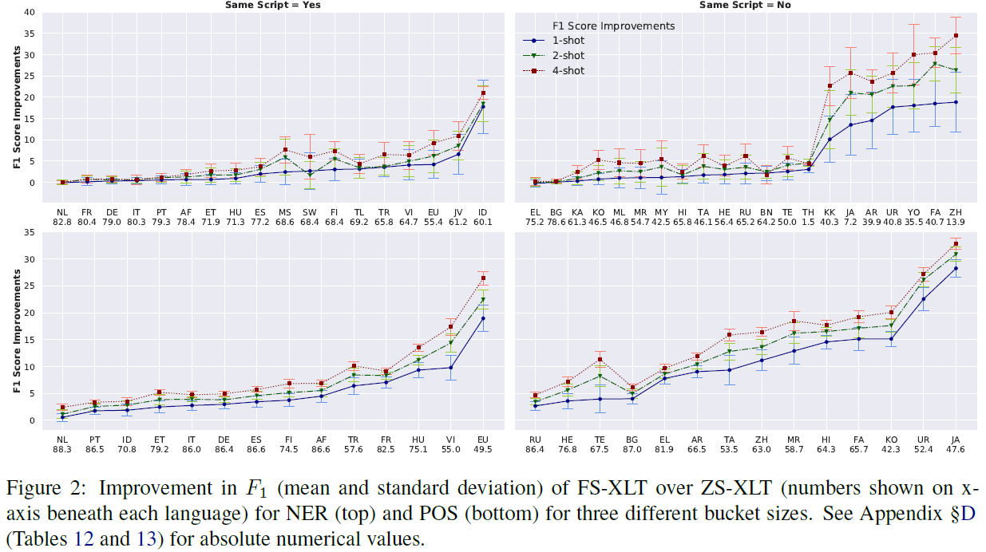
Different Numbers of Shots
16
Notes:
介绍data to text任务

Slide 17
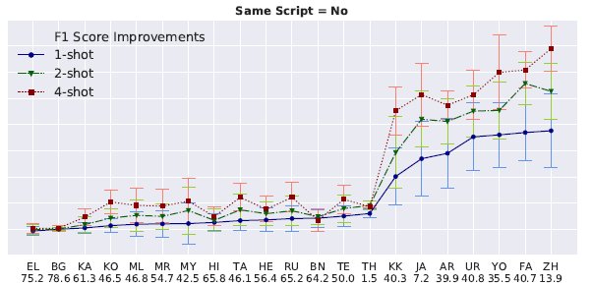
Different Numbers of Shots
17
Notes:
One shot 增长的最多
随着K增大，增大的幅度变小
40个桶的方差随着K
的增加而减小。

Slide 18
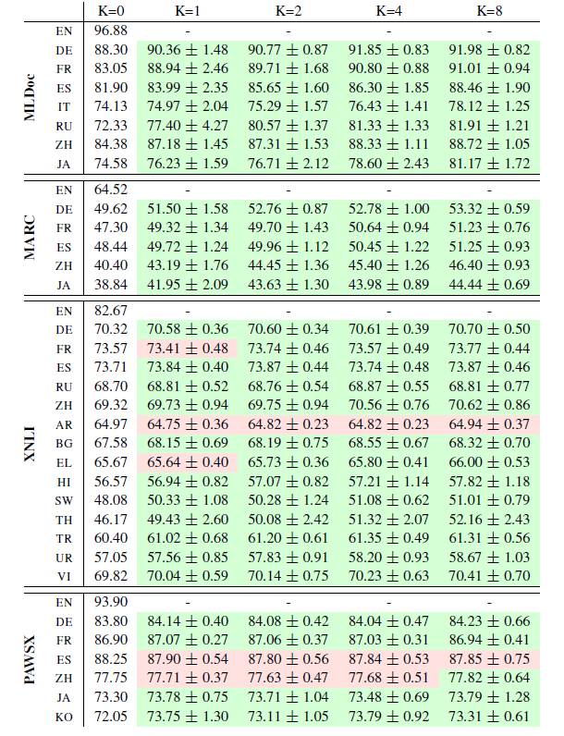
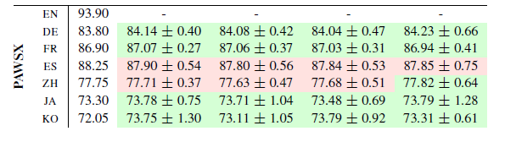
Different Numbers of Shots
1-shot buckets bring the largest relative performance
the gains follow the increase of K, but with diminishing returns
the performance variance decreases as K increases.
18
Notes:
One shot 增长的最多
随着K增大，增大的幅度变小
40个桶的方差随着K
的增加而减小。

Slide 19
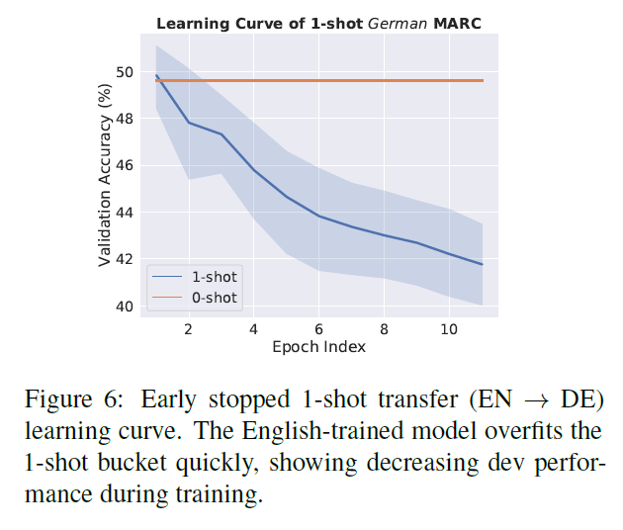
Different Numbers of Shots
overfit the buckets quickly at small values K
19
Notes:
介绍data to text任务

Slide 20
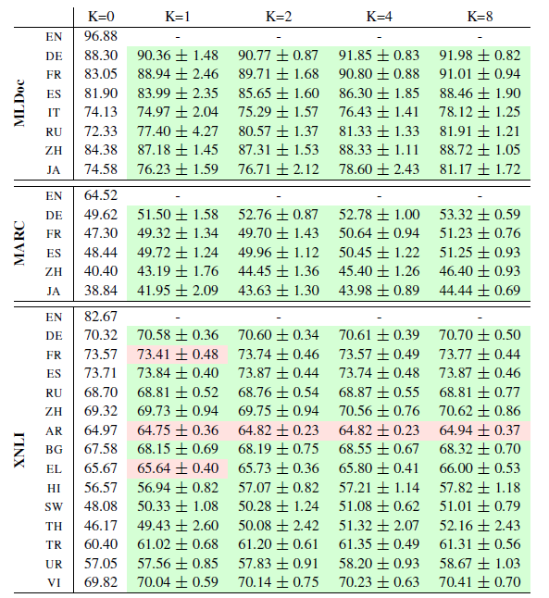
Different Downstream Tasks
FS-XLT benefits MLDoc the most
Improves modestly (XNLI) or even decreases (PAWSX-ES)
POS and NER benefit from FS-XLT substantially
Small shot + semantic tasks may not help
20
Notes:
Pos+ner 不需要推理
训练测试不可避免的有词汇重叠

Slide 21
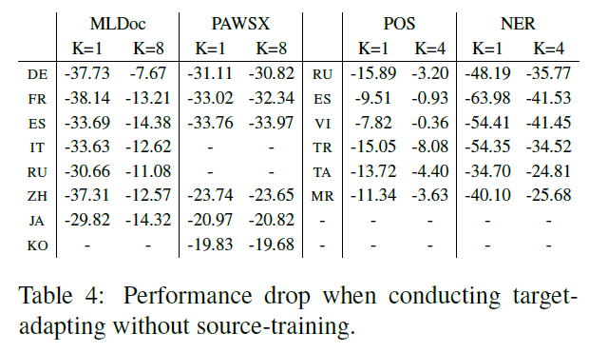
Source-training
21
Notes:
Pos+ner 不需要推理
训练测试不可避免的有词汇重叠

Slide 22
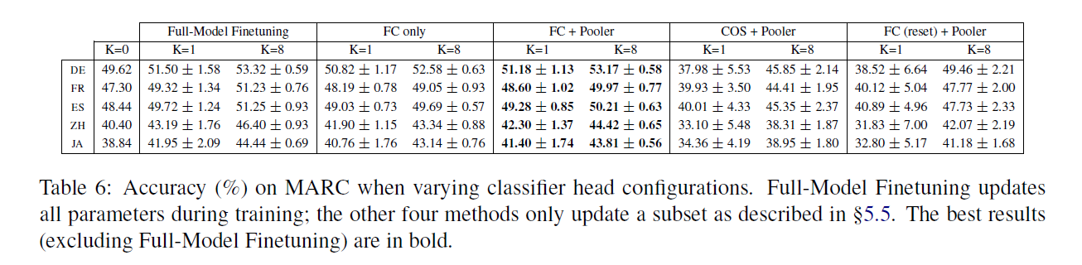
Target-Adapting Methods
Freeze the embedding and transformer layers of mBERT
Full model finetuning (without freezing).
22
Notes:
Pos+ner 不需要推理
训练测试不可避免的有词汇重叠

Slide 23
Conclusion
不同的测试任务间差异很大，随着K增大，差异减小
不同的随机种子也会有影响（但是差异相对没有那么明显1-2%的差距）
不同的目标语言差异也比较明显
不同的下游任务的跨语言迁移影响也不同（CLS类任务表现不好NER等任务表现还不错，因为后者只需要浅层的语法知识）
还研究了K的影响，相比于零样本少样本增益很大，但是随着K的增大增益变得不再明显
用简单的模型直接fine-tune比sota的少样本学习fine-tune表现要好
23
Notes:
Pos+ner 不需要推理
训练测试不可避免的有词汇重叠

Slide 24
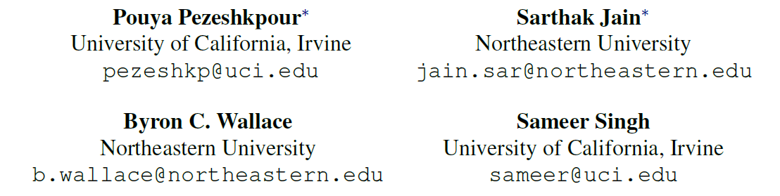
An Empirical Comparison of Instance Attribution Methods for NLP
24
Notes:
作者单位
根据explanation来进行关系分类

Slide 25
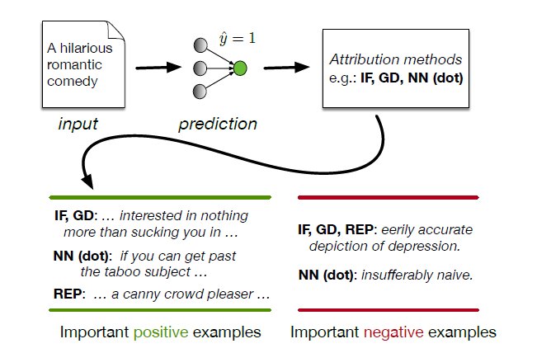
Instance Attribution Methods
Retrieve training instances that (may have) led to a particular prediction
25
Notes:
我们的结构做的就是颠倒假设

Slide 26
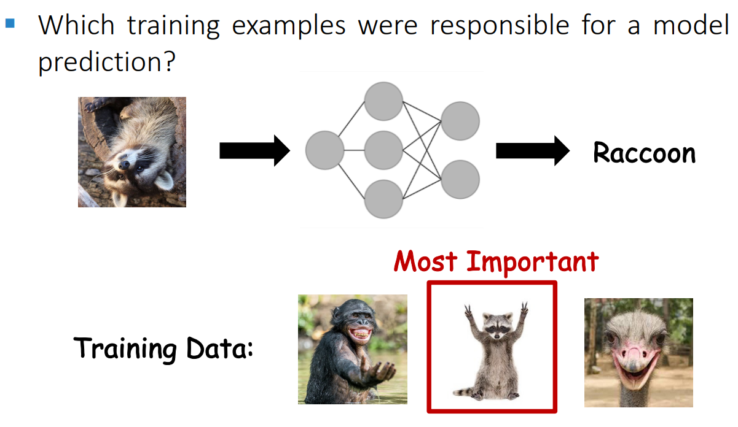
Instance Attribution Methods
26
Notes:
我们的结构做的就是颠倒假设

Slide 27
Instance Attribution Methods
Retrieve training instances that (may have) led to a particular prediction
Similarity Based Attribution
Gradient Based Attribution
Correlation
quality of explanations
27
Notes:
我们的结构做的就是颠倒假设

Slide 28
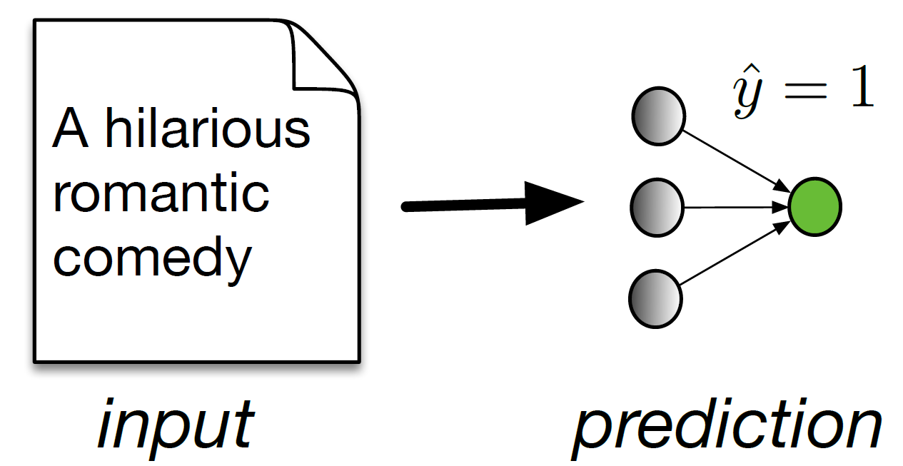
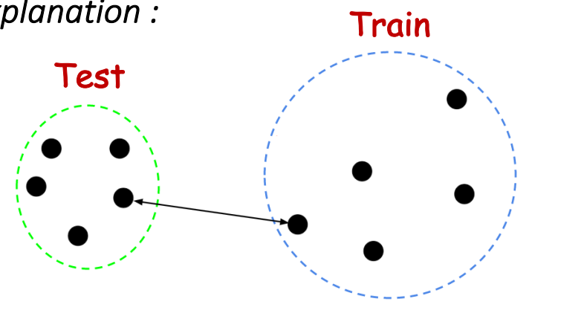
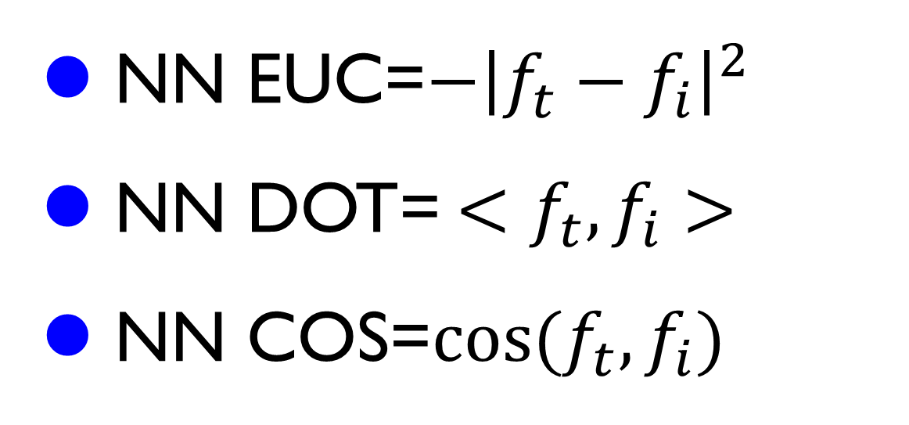
Similarity Based Attribution
NN EUC=$−{\left|f_{t}−f_{i}\right|}^{2}$
NN DOT= ${<f}_{t},f_{i}>$
NN COS=$\cos{{(f}_{t},f_{i})}$
28
Notes:
我们的结构做的就是颠倒假设

Slide 29
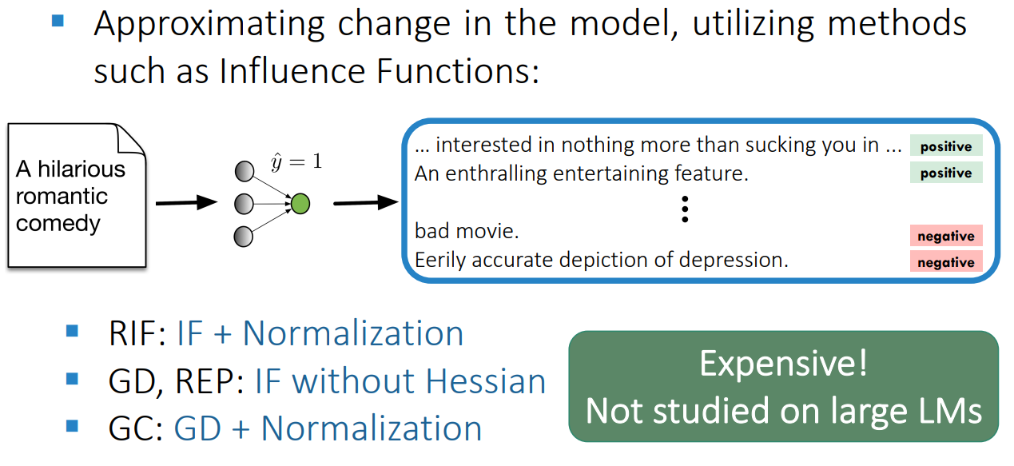
Gradient Based Attribution
29
Notes:
我们的结构做的就是颠倒假设

Slide 30
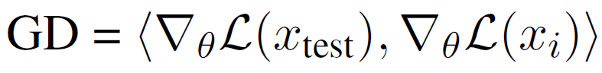
Gradient Based Attribution
30
Notes:
我们的结构做的就是颠倒假设

Slide 31
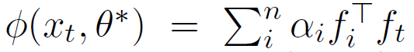
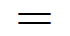
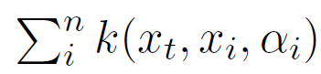
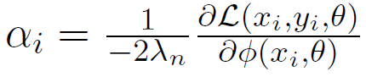
Gradient Based Attribution
31
Notes:
我们的结构做的就是颠倒假设

Slide 32
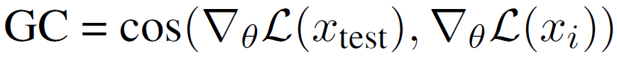
Gradient Based Attribution
32
Notes:
我们的结构做的就是颠倒假设

Slide 33
Gradient Based Attribution
33
Notes:
我们的结构做的就是颠倒假设

Slide 34
Experiment
Dataset
Stanford Sentiment Treebank(SST-2)
Multi-Genre NLI(MNLI)
Model：BERT
IF for BERT
top five layers [IF (Top-5)]
only the last linear layer [IF (linear)]
34
Notes:
他这个解释机制有四个指标。我原来以为这篇论文产生的explanation是自然语言的explanation，从而提高可解释性。读完才发现这篇论文是生成了一下几个指标来看模型的可以解释性。第一个指标是α，这个比较简单，看的是每个句子对于预测bag的权重。
第二个指标是Saliency:对于关系k，每个输入xn对ok的影响，其中ok是一个函数，表示模型中关系k的逻辑分数。有点像输出对于输入的梯度影响。
第三个指标是梯度*输入，也就是用每个输入xn乘以函数对xn的梯度。
第四个指标，看的是删除一个样本xn对于函数的影响。

Slide 35
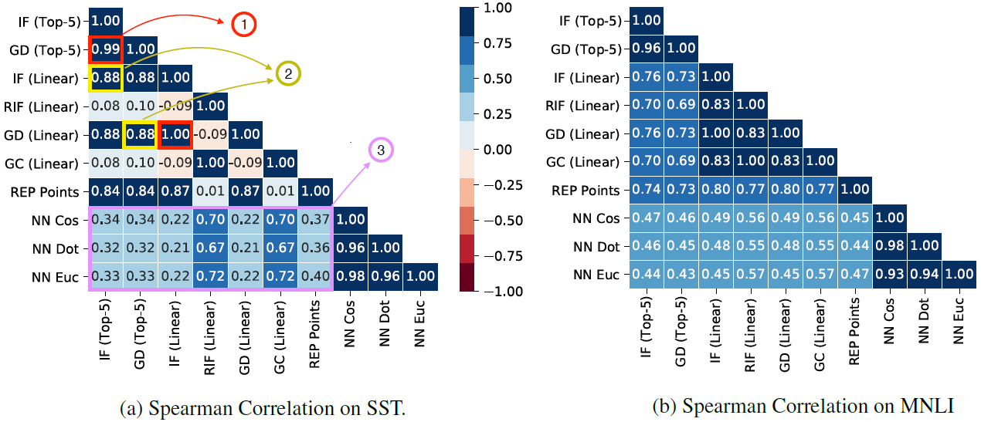
Correlation
Hessian information may not be necessary
35
Notes:
1 = Using Hessian does not change the ordering of
training examples. 2 = Using more layers of BERT in IF approximation does not much affect the ordering. 3 =
NN metrics are not well correlated with gradient-based ones.

Slide 36
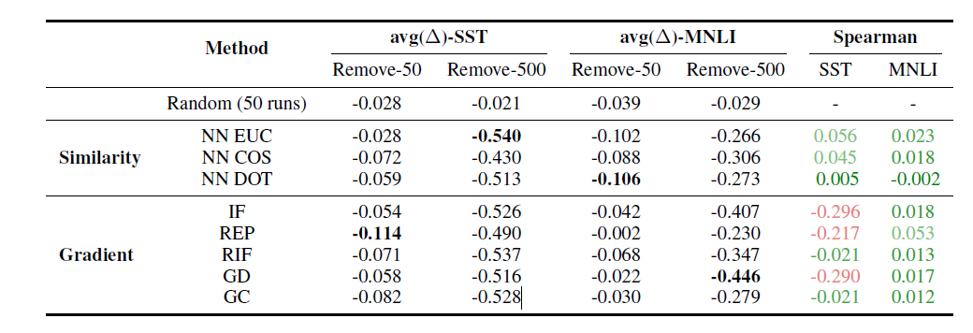
Removing ‘Important’ Samples
36
Notes:
计算训练模型和随机初始化模型的相关度

Slide 37
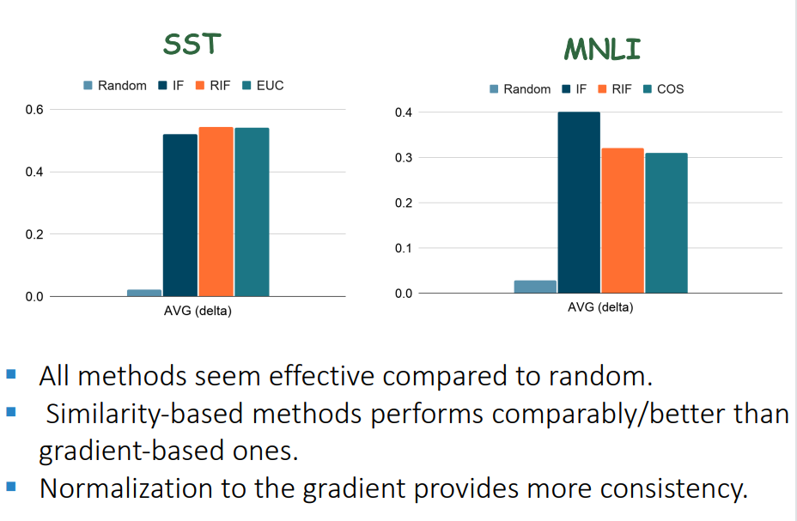
Removing ‘Important’ Samples
37

Slide 38
Conclusion
Hessian information may not be necessary
Simple similarity-based methods are surprisingly competitive
38

Slide 39
NLP
N way K shot
FEW-NERD
FewRel
FewEvent
Cross lingual
Unsupervised Learning
39
Notes:
对于VQA任务中同一幅图片

Slide 40
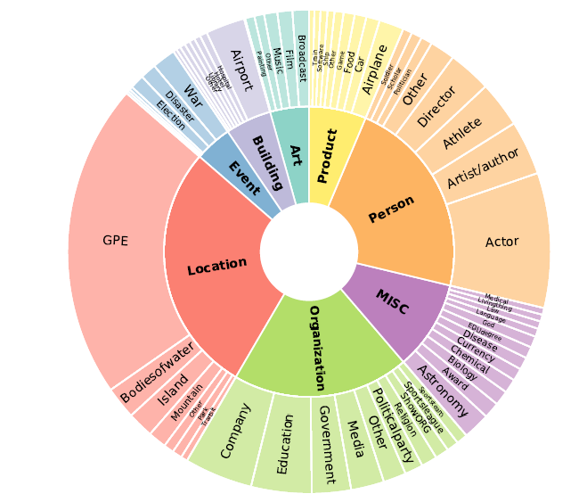
FEW-NERD
New
8 coarse-grained entity types
66 fine-grained entity types
Construct train, dev and test according to the coarse-grained
coarse-grained types are shared.60/20/20
[ACL21]FEW-NERD: A Few-shot Named Entity Recognition Dataset
40
Notes:
这是一个例子

Slide 41
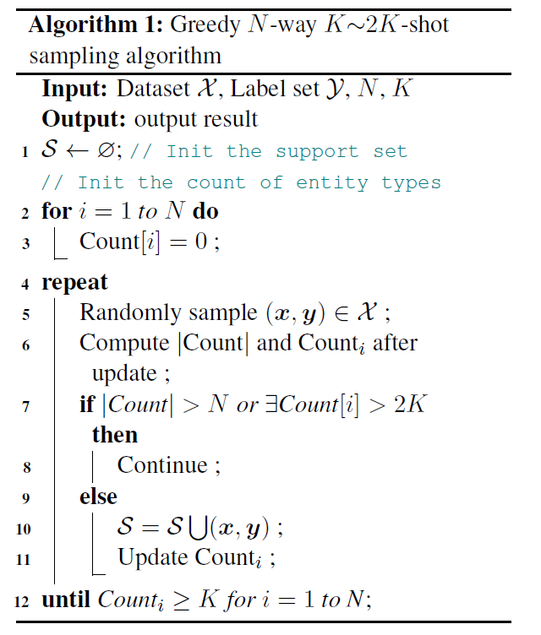
Sampling
Sentence may contain multiple entities from different classes.
[ACL21]FEW-NERD: A Few-shot Named Entity Recognition Dataset
41
Notes:
这是一个例子

Slide 42
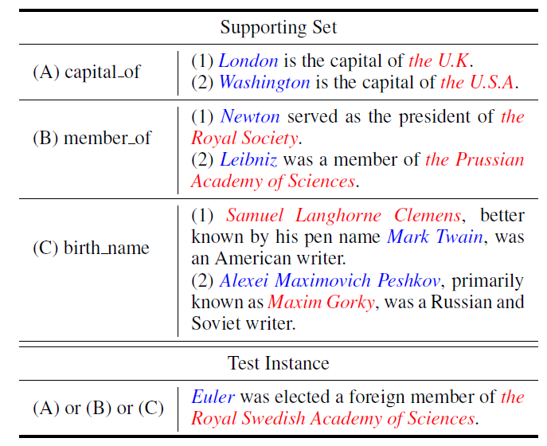
Fewrel
100 relation
700 instances/relation
64/16/20
[ACL18]FewRel: A Large-Scale Supervised Few-Shot Relation Classification
Dataset with State-of-the-Art Evaluation
42
Notes:
这是一个例子

Slide 43
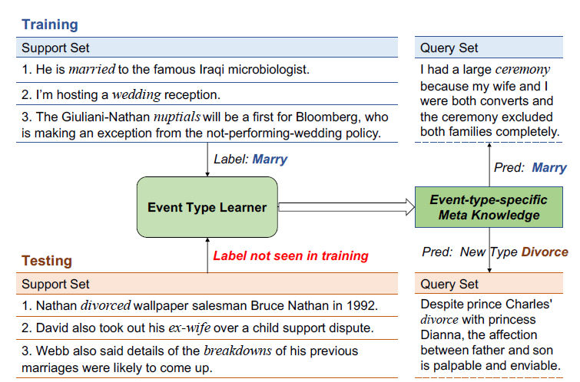
Fewevent
100 event type
80/10/10
[WSDM 2020]Meta-Learning with Dynamic-Memory-Based Prototypical
Network for Few-Shot Event Detection
43
Notes:
这是一个例子

Slide 44
Cross-lingual-NER
Cross-lingual NER with minimal resources
Annotation projection(first translate)---noisy
Direct transfer(Cross-lingual word embeddings)
Direct transfer + meta learning
单个句子来构造任务
[AAAI20]Enhanced Meta-Learning for Cross-lingual Named Entity Recognition with
Minimal Resources
44
Notes:
介绍data to text任务

Slide 45
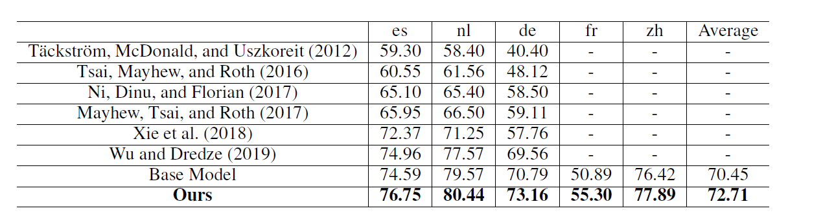
Cross-lingual-NER
[AAAI20]Enhanced Meta-Learning for Cross-lingual Named Entity Recognition with
Minimal Resources
45
Notes:
将句子送到bert中，得到每个单词的向量表示，然后加一个线性
层，得到每个词的label，如果一个词被分为多个subword，取第一个
subword的label作为最终的label

Slide 46
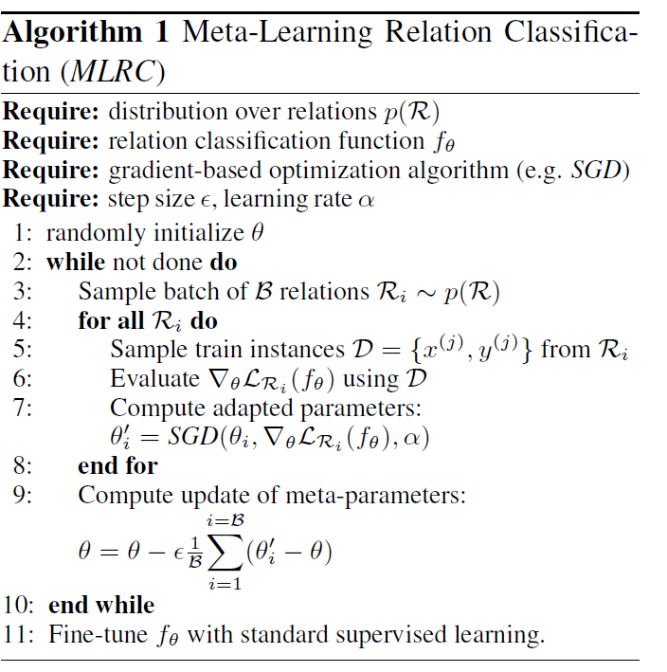
MLRC
单个关系来构造任务
单个任务上更新临时参数，平均后更新在θ上
和MAML不同
[ACL19] Model-Agnostic Meta-Learning for Relation Classification with Limited Supervision
46
Notes:
介绍data to text任务

Slide 47
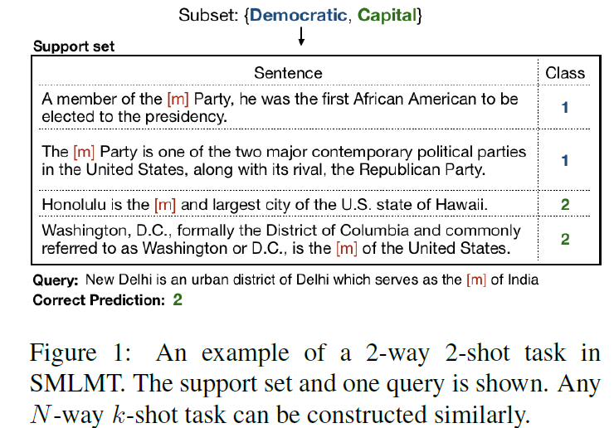
SMLMT
N way K shot = N mask works K sentences
任务数量足够多
[ACL19] Model-Agnostic Meta-Learning for Relation Classification with Limited Supervision
47
Notes:
介绍data to text任务

